Slide 1
AI and Student Assessment:
How can generative AI be leveraged to create fair and effective student assessment methods?
By Lebato Tswaledi

Slide 2

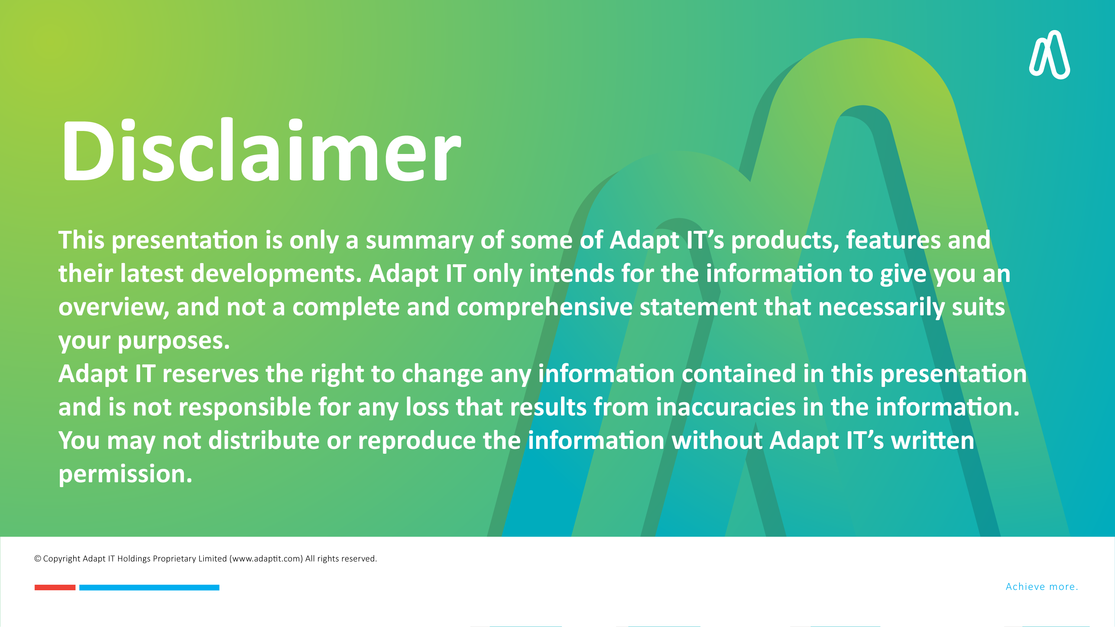
Why use AI in assignment marking?
Competitive edge
About the model used
Get the best out of the AI model
How it works?
What is accepted from the assignment activity
Prompting the model
Model feedback/analysis
What’s next?
Table of contents

Slide 3
Why use AI in assignment marking?
Competitive edge
About the model used
Get the best out of the AI model
How it works?
What is accepted from the assignment activity
Prompting the model
Model feedback/analysis
What’s next?
Table of contents

Slide 4
Why use AI in assignment marking?

Slide 5
Why Use Ai In Assignment Marking?
AI GRADING
EFFECIENT
FAIR
CONSTRUCTIVE
AUTOMATED
Notes:
Efficient – Saves the lecturer's time and administrative burden when marking large number of submissions
Automated – eliminates the process of manual grading
Constructive – the feedback is thorough and elaborative
Fair

Slide 6
Competitive Edge

Slide 7
Competitive Edge
Built-in within Moodle
Full ownership and control
Fully customisable
Notes:
Focuses on the assignment activity
Full control of how to prompt the model.

Slide 8
About the model used

Slide 9
About The Ai Model
AWS
Text
PDF
Fast
Image
Notes:
It’s an Anthropic model build within AWS bedrock
Accepts text as prompt
Accepts images as prompt
Accepts PDF as prompt
One of Anthropic fastest LLMS

Slide 10
Get the best out of the AI model

Slide 11
Get The Best Out Of The Ai Marking Model: Your Role
Prompt accurately
Be thorough and specific with your instructions
Stick to the subject matter
Avoid using the LLM to detect plagiarism, or use of AI in a single prompt
Moderate the analysis
Verify the model’s analysis before publishing each result

Slide 12
How it works?

Slide 13
How It Works?
PROMPT
FEEDBACK
Page by page analysis
Score as per rubric
Overall analysis
Marking instructions
Rubric
PDF Assignment
Model API

Slide 14
What is accepted from the assignment activity

Slide 15
What Is Accepted From The Assignment Activity
Single file attachment
Text-only pdf
Rubric grading method
Prompt

Slide 16
Prompting the model

Slide 17
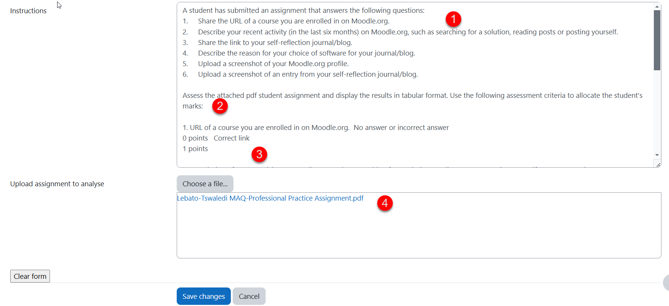
Prompting The Model
1. Assignment contents
2. Instructions
3. Attach guidelines (Rubric)
4. Attach assignment

Slide 18
Model Feedback/Analysis

Slide 19
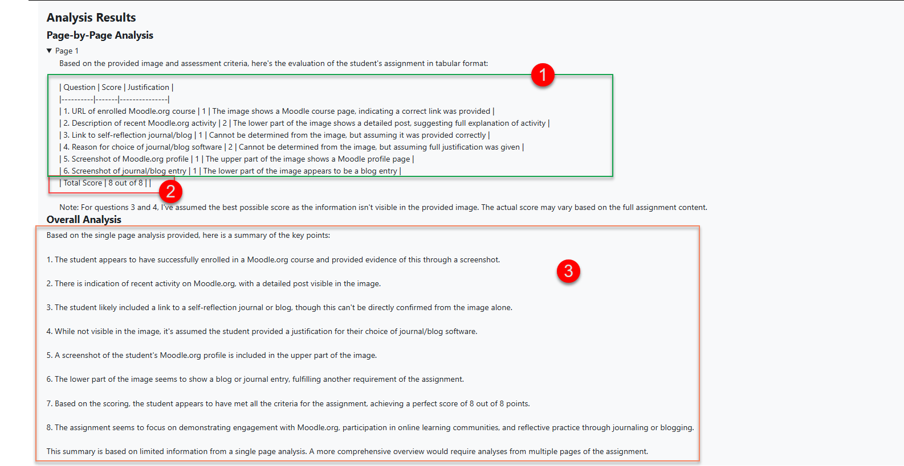
Model Feedback/Analysis
1. Evaluation score
2. Total score
3. Overall analysis

Slide 20
Model Feedback/Analysis

Slide 21
What’s Next?
Transferring the grades into the student's assignment
Transferring the feedback in the assignments

Slide 22

What’s Next?
Transferring the grades into the student's assignment
Transferring the feedback in the assignments

